Slide 1
SCO421: Computer Vision
PROJECTS

Slide 2

BIG PICTURE
Teamwork & MATLAB
Chose one idea
Implement it using the two approaches (hand-crafted vs. data-driven)
Technology Evaluation: [80%]
Compare the two approaches on existing DB(s) & Report the results
Scenario Evaluation: [20%]
Apply it using your own data on simple but real application GUI

Slide 3
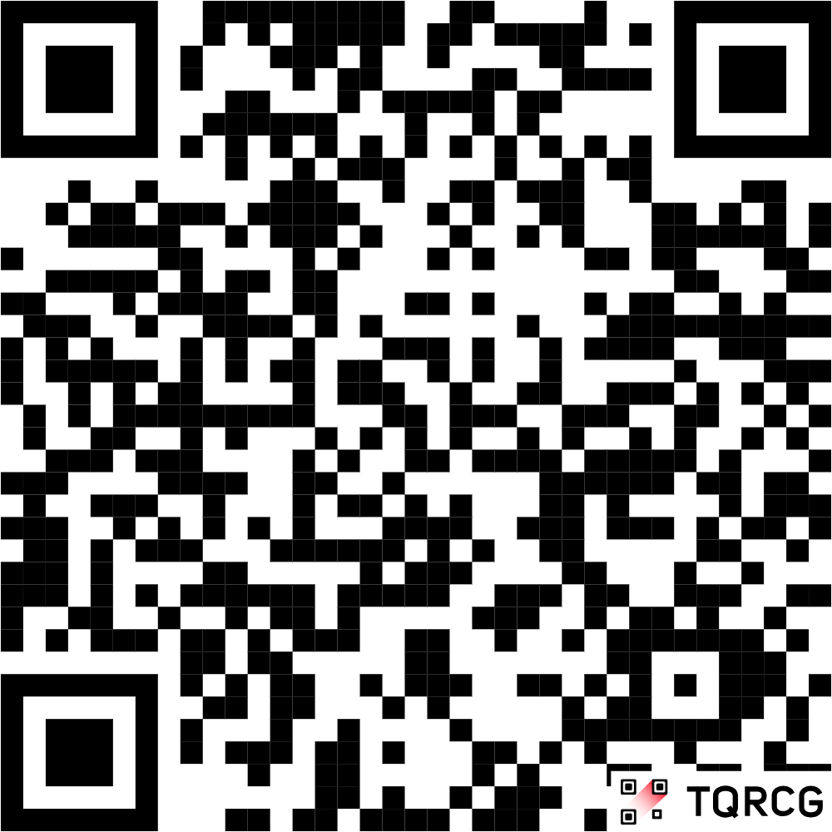
LOGISTICS
Chose by filling this form
DUE TO: WED 8 APR 23:59 isA
Two Prioritized Wishes
Max: 5 Teams per Idea
Selection Criteria: Team Marks (Ass1 & MT)
DUE TO: End of Week#12 (~3 Weeks)
ONE-MEMBER teams are asked to implement & deliver the "Technology Evaluation" of "Hand-Crafted Approach" ONLY
Extra Credit
Application with best accuracy

Slide 4
DETAILS
Technology Evaluation |  | 80%
1) Hand-Crafted | Preprocessing & Segmentation Feature Extraction & Matching TESTING: SEEN Cases & UNSEEN Cases | 40%
2) Data-Driven | Select a dataset Apply one of the following methods: Build a model from scratch Transfer-learning an existing model Fine-tune and existing model TESTING: SEEN Cases & UNSEEN Cases | 20%
ONE-MEMBER TEAMS ARE ASKED TO DELIVER THIS PART ONLY
Results MUST be Enhanced

Slide 5
DETAILS
Technology Evaluation |  | 80%
GUI | BROWSE a single image: apply the algorithm/model and display the output BROWSE ALL SEEN test cases: apply the algorithm/model on each image and display its output ACQUIRE image from camera: apply the algorithm/model and display the output | MANDATORY
Document | Hand-Crafted: Briefly describe the steps & used algorithms/methods Data-Driven: Briefly describe the used model & method Results: Compare two approaches on SEEN Cases Compare results before and after transfer-learn/fine-tune | 20%

Slide 6
DETAILS
Scenario Evaluation (GUI App) |  | 20%
1) Running Code | Acquisition from Camera Apply the algorithm Output the result on GUI | 15%
2) Real-time Testing | One (or more) live samples | 5%

Slide 7
DESCRIPTIONS
Time Teller
Shooting Target Score
Road Signs Detection and Recognition
Detection and Recognition of Egyptian National ID

Slide 8


